Slide 1
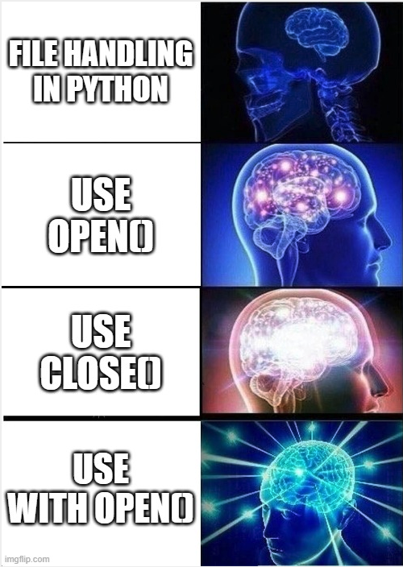
Files and exceptions

Slide 2
How to open a file
To work with a file, you need to open it inside your python program - can be done by using the open() function (read more about open() and close() in chap. 9 of ATBS)
By using the keywork ‘with’ before the open() function, python will figure out when to open the file and close it when it is no longer needed
In this example, python will return an object representing the file ‘names.txt’ and store this object in the variable names_file
Remember to check if your file is in the same directory as your program. If not, you need to use relative or absolute paths in your open() function

Slide 3
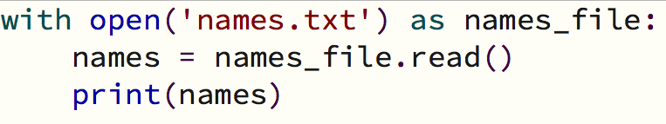
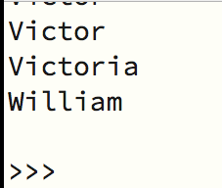
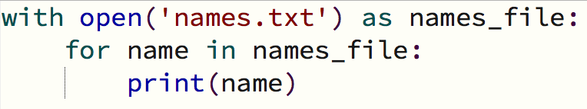
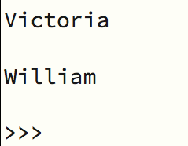
Reading from a file
read(): will read the entire content of the file and store it as one long string in a variable. Will also return an empty string when it reaches the end of the file which will show up as a blank line
for loop: a for loop can be used to examine each line of the file by looping over the content

Slide 4
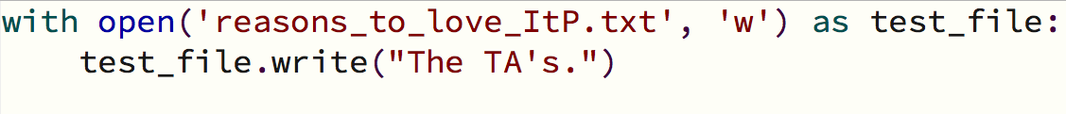
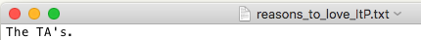
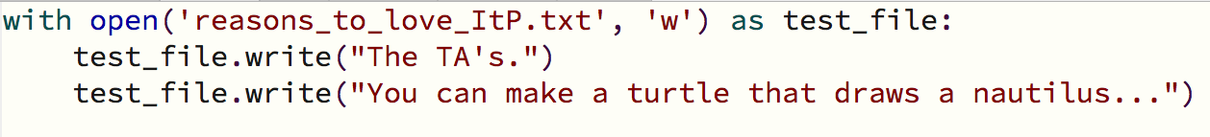
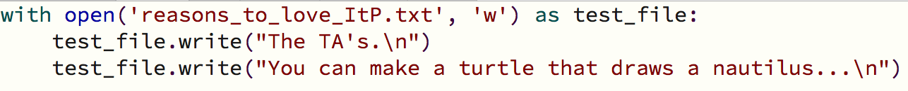


Writing to a file
To write to a file, you need to call open() with a second argument ‘w’ and then use the write() function
When writing multiple lines, the write() function will not add new lines to the text, so you will have to write them
Writing to the same file again, will overwrite the current content of the file

Slide 5

Appending to a file
Using ‘a’ – append mode – instead of ’w’ – write mode - will append to a file instead of overwriting existing content

Slide 6
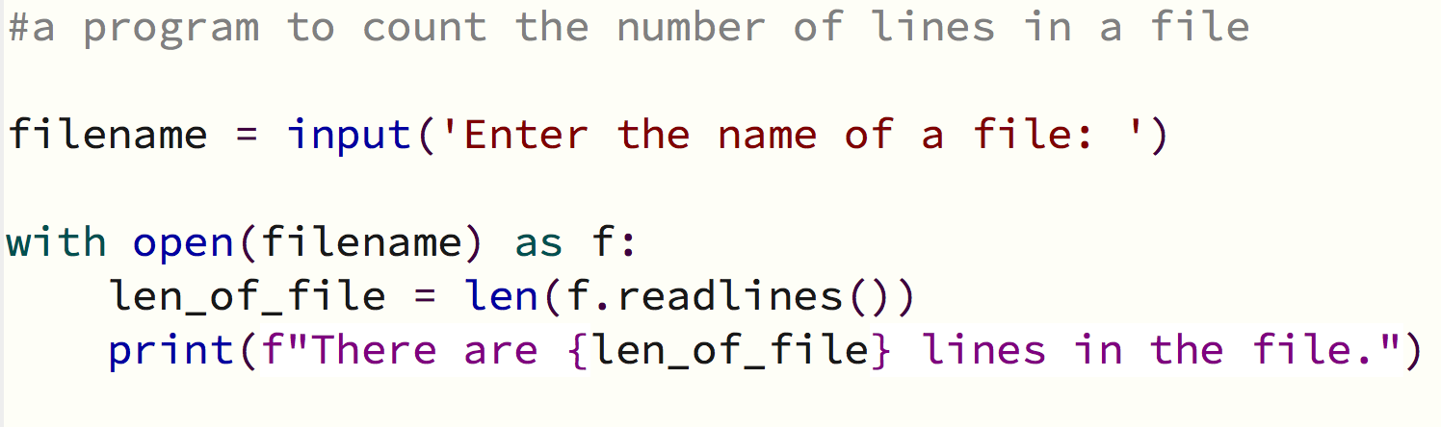
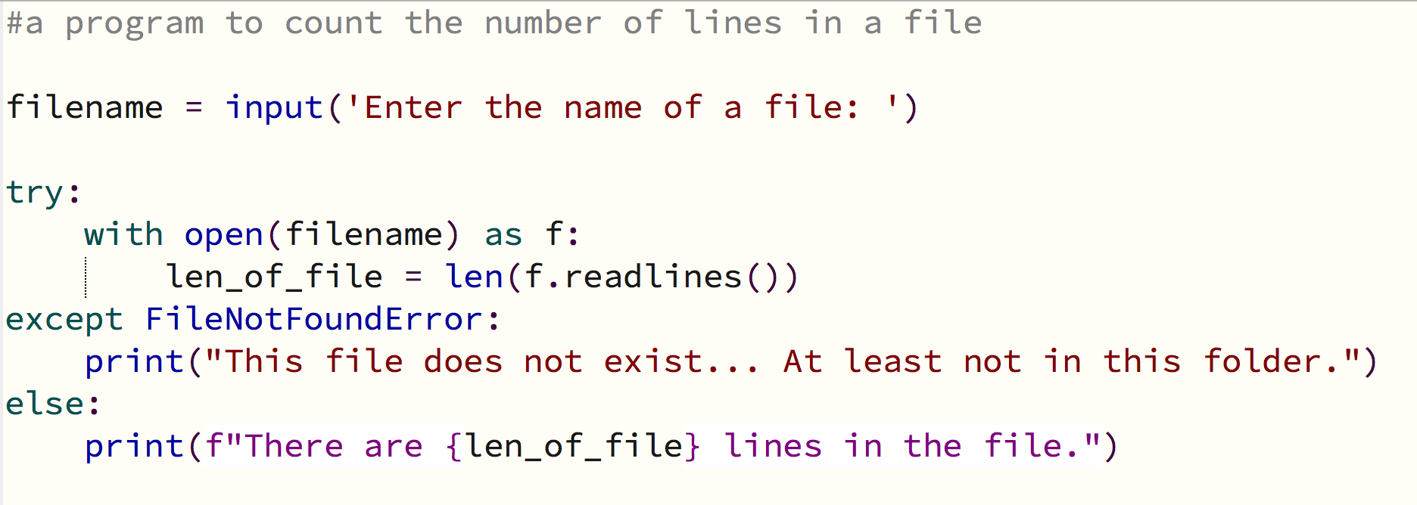
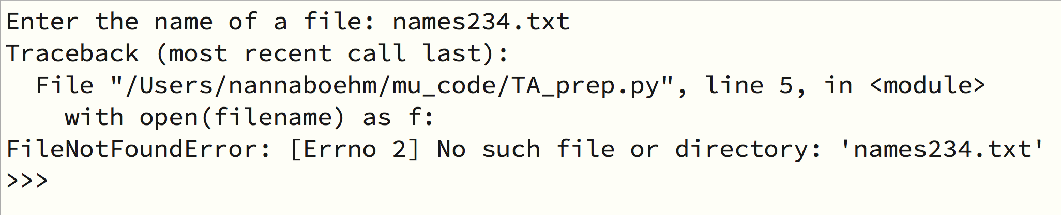
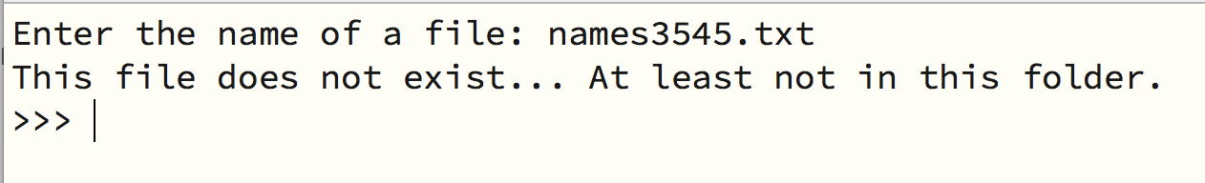
Try and except
A program will crash when an error occurs unless you use a try-except block
By using a try-except block, you can handle the error smoothly and the rest of the program will still run...

